Slide 1
NUMBERS FACT
A simple mobile Application for quite interesting facts.

Slide 2
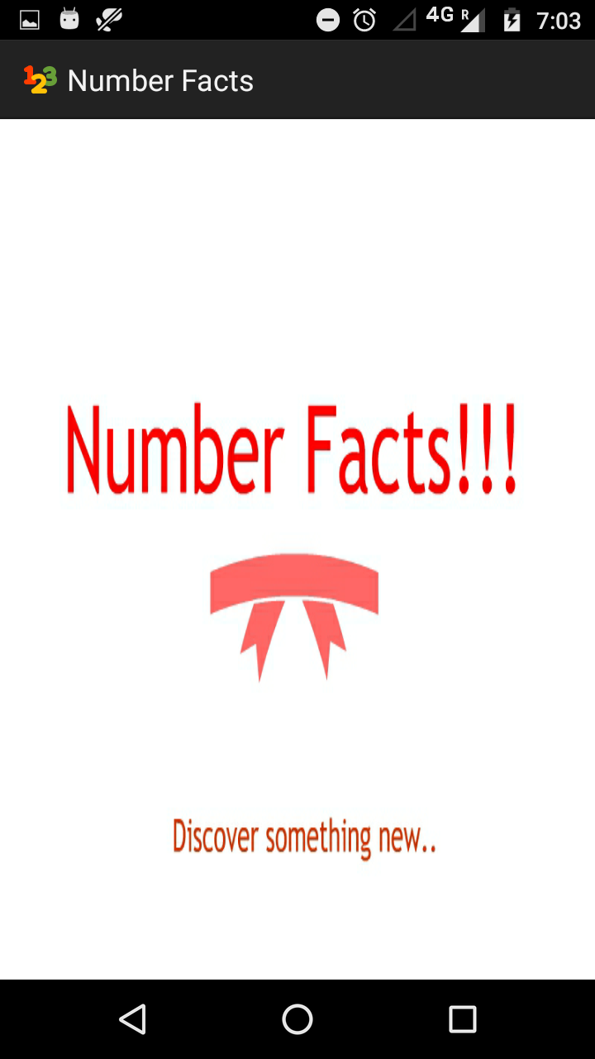
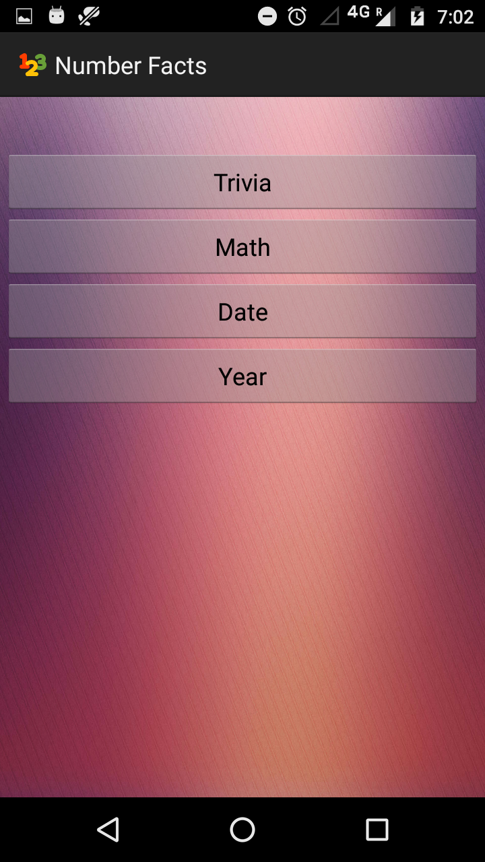
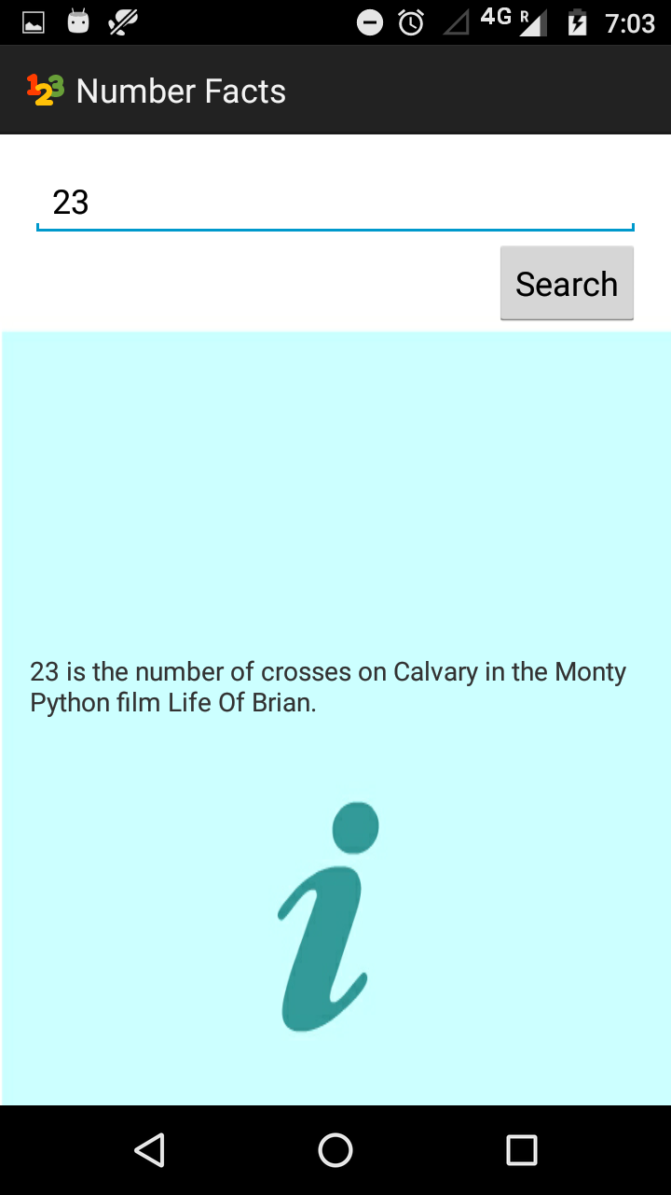
My Layout :

Slide 3
My Idea:
Main Layout consists of 4 buttons each leads to different category. On click property was fixed to each button . On clicking the button new intent was created which leads to new activity .
New activity consists of a edit-text where the user inputs the number and a search button. The result obtained was displayed in textview.
In case of no network connection error was displayed .

Slide 4
Coding samples:
On click property for each button :
trivia.setOnClickListener(new View.OnClickListener() {
@Override
public void onClick(View v) {
Intent myIntent = new Intent(MainActivity.this,
NewActivity1.class);
startActivity(myIntent);
}
});

Slide 5
Main concept of retrieving the information from API
URL url = new URL(API_URL+val+ "/" +category);
HttpURLConnection urlConnection = (HttpURLConnection) url.openConnection();
try {
BufferedReader bufferedReader = new BufferedReader(new InputStreamReader(urlConnection.getInputStream()));
StringBuilder stringBuilder = new StringBuilder();
String line;
while ((line = bufferedReader.readLine()) != null) {
stringBuilder.append(line).append("\n");
}
bufferedReader.close();
return stringBuilder.toString();
}
finally{
urlConnection.disconnect();
}

Slide 6
THANK YOU

